Slide 1
1010043316
Analysis and Design of Algorithms
Unit 5: ANALYSIS AND DESIGN ALGORITHMS LECTURE COMPANION
SEMESTER: 5

Slide 2
BACKTRACKING AND BRANCH AND BOUND ALGORITHM
Introduction of Backtracking:
Recursive approach and it is refinement of brute force method.
Often faster than brute force approach.
Generate all partial candidates that could generate complete solution.
Partial solutions are explored in DFS order.
Decision problem:we search for the feasible solution
Optimization problem:we search for the best solution.

Slide 3
Backtracking
Problem:
Find out all 3 bit binary number for which the sum of the 1’s is greater than or equal to 2.
The only way to solve this problem is to check all possibilities:(000,001,010,...,111)
The 8 possibilities are called the search space of the problem.They can be organized into a tree.

Slide 4
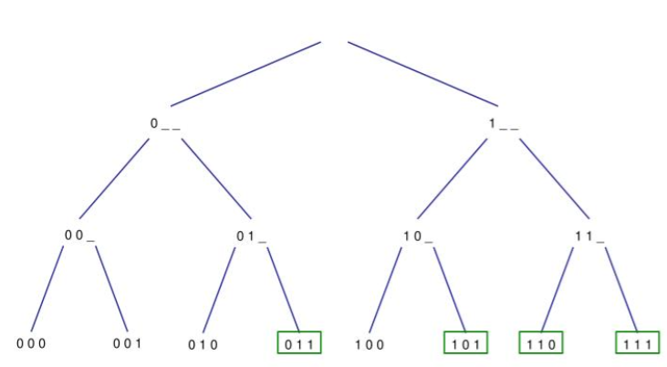
Processing of Backtracking
For some problem, the only way to solve is to check all possibilities.
Backtracking ia a systematic way to go through all the possible configuration of a search space.
The principle idea of backtracking is to construct solutions as component at a time and then evaluate such partially constructed solutions.

Slide 5
Advantages of Backtracking
Best option for solving tactical problem.
Backtracking is effective for constraint satisfaction problem.
Simple to implement and easy to code.
Comparison with DP, Backtracking approach is more effective in some cases.

Slide 6
Disadvantages of Backtracking
The overall runtime of Backtracking algorithm is normally slow
Need large amount of memory space
Thrashing is one of the main problem of Backtracking.
To solve large problem sometimes it needs to take help of other techniques like Branch and Bound.
The basic approach detects the conflicts too late.

Slide 7
Application of Backtracking
Constraints satisfaction problem
Electrical Engineering
Robotics
Artificial Intelligence
Genetic and bioinformatics algorithm
Network communication
Solving puzzle and path

Slide 8
N-Queen Problem
Problem:
To place n queens on an n by n chessboard so that no two queens attack each other by being in the same row, or in the same column, or in the same diagonal.
Observation:
Case 1 : n=1
Case 2 : n=2
Case 3 : n=3
Case 4 : n=4

Slide 9
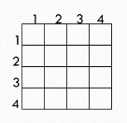
N-Queen Problem
For example:
To explain n queen problem, n=4 using a 4 by 4 chessboard where 4 Queens have to be placed in such a way so that no two queen can attack each other.

Slide 10
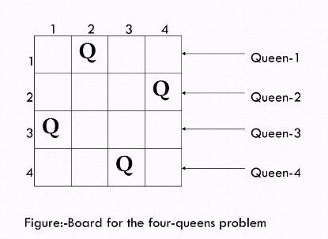
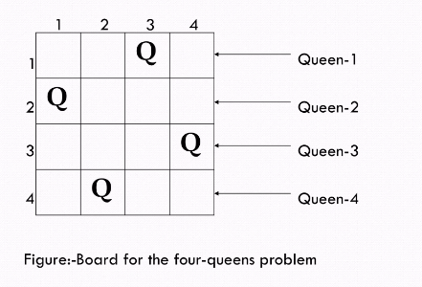
We can obtain two solution shown in the figure.

Slide 11
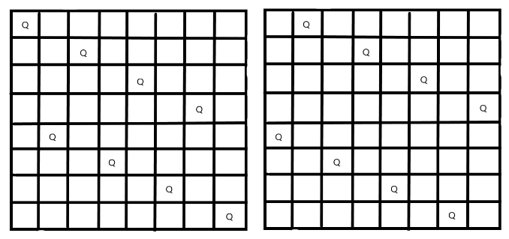
8 Queen Problem
Define an 8 by 8 array
Search space is very huge - 16,772,216 possibilities
Each row ,column and diagonal will have exactly one queen

Slide 12
BACKTRACKING
BRANCH AND BOUND
Backtracking traverses the state space tree by DFS
Involves feasibility function
Used for solving decision problem
More efficient
Next move from current state can lead to bad choice.
Useful in solving N Queen Problem , sum of subset ,Hamilton cycle,Graph coloring problem.
Branch and bound traverses by DFS or BFS.
Involves bounding function
Used for solving Optimisation Problem.
Less efficient
Next move is always towards better solution.
Useful in solving knapsack Problem,Travelling salesman Problem.

Slide 13
Knapsack Problem
function backTrack Sack(m,W)
{
value =0;
for i = m to n
{
if (w[i]<=W)
{
value =maximum(value, v[i]+backTrack Sack(i,W-w[i]))
}
return Value;
}

Slide 14
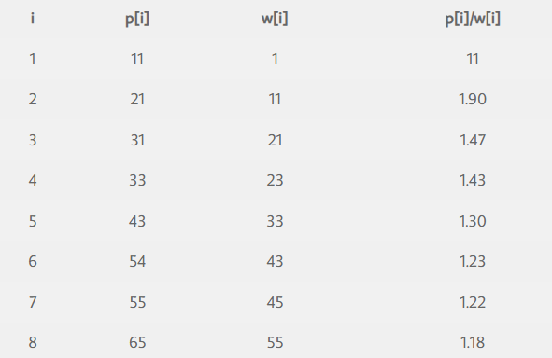
KNAPSACK PROBLEM
EXAMPLE: Consider knapsack problem : n =8. (W1,W2,W3,W4,W5,W6,W7,W8)=(1,11,21,23,33,43,45,55) P=(11,21,31,33,43,53,55,65) , m=110 Solve the problem using backtracking approach.

Slide 15
Knapsack Problem
Here M = 110 and n = 8.
Initially, cp = cw = 0, fp = – 1, k = 0
For k = 1:
cp = cp + p₁ = 0 + 11 = 11
cw = cw + w₁ = 0 + 1 = 1
cw < M, so select item 1
k = k + 1 = 2

Slide 16
Knapsack Problem
For k=1:
cp = cp + p₂ = 11 + 21 = 32
cw = cw + w₂ = 1 + 11 = 12
cw < M, so select item 2
k = k + 1 = 2
For k = 2:
cp = cp + p₃ = 32 + 31 = 63
cw = cw + w₃ = 12 + 21 = 33
cw < M, so select item 3
k = k + 1 = 3

Slide 17
Knapsack Problem
For k = 3:
cp = cp + p₄ = 63 + 33 = 96
cw = cw + w₄ = 33 + 23 = 56
cw < M, so select item 4
k = k + 1 = 4
For k = 4:
cp = cp + p₅ = 96 + 43 = 139
cw = cw + w₅ = 56 + 33 = 89
cw < M, so select item 5
k = k + 1 = 5

Slide 18
Knapsack Problem
For k = 5:
cp = cp + p₆ = 139 + 53 = 192
cw = cw + w₆ = 89 + 43 = 132
cw > M, so reject item 6 and find upper bound
cp = cp – p₆ = 192 – 53 = 139
cw = cw – w₆ = 132 – 43 = 89
ub = cp + ((M – cw ) / w _{i+1}) * p_{i+1}
b = cp + [(110 – 89) / 43] * 53 = 164.88
Inclusion of any item from {I₆, I₇, I₈} will exceed the capacity.
So let’s backtrack to item 4.
Upper bound at node 1:
ub = cp + ((M – cw ) / w _{i+1}) * p_{i+1}
= 139 + [(110 – 89)] / 43 * 53 = 164.88
Upper bound at node 2:
= 96 + [(110 – 56) / 33] * 43 = 166.09
Upper bound at node 3:
= 63 + [(110 – 33) / 33] * 43 = 163.33

Slide 19
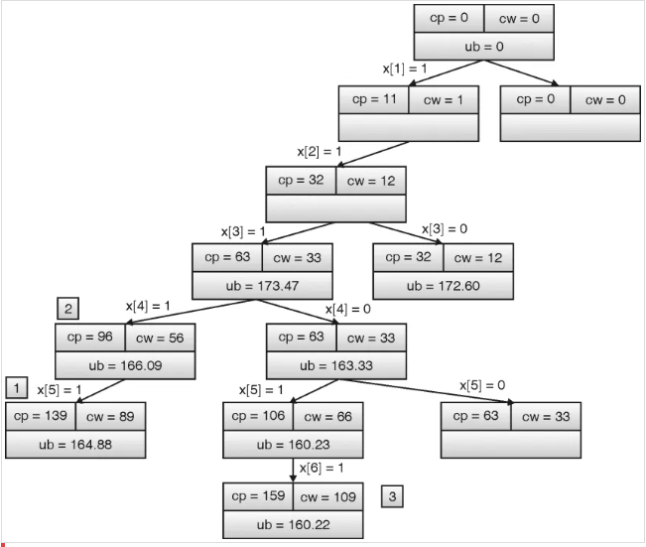
Knapsack Problem

Slide 20
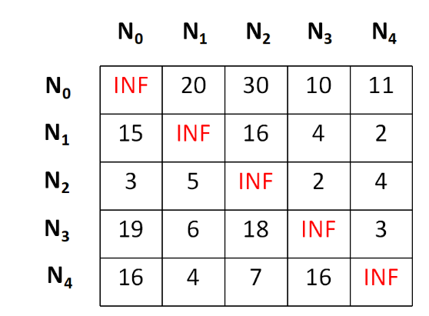
Travelling salesman Problem
For example, suppose we have a cost matrix as shown below

Slide 21
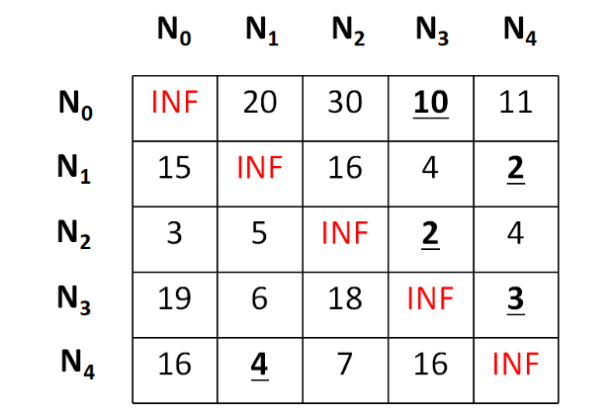
Travelling salesman Problem
First of all we will perform the row operations and to do the same, we need to subtract the minimum value in each row from each element in that row. The minimums and the row reduced matrix is shown below

Slide 22
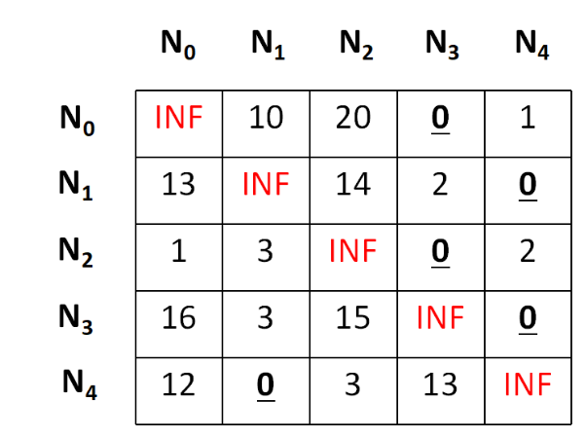
Travelling salesman Problem
And after row reduction,

Slide 23
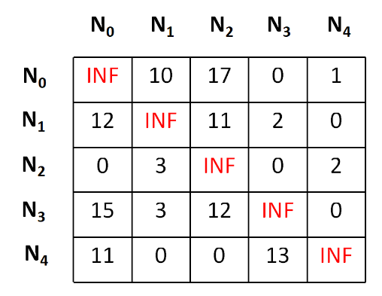
Travelling salesman Problem
we need to perform the column operation in the same manner and we will get a final matrix as below,,

Slide 24
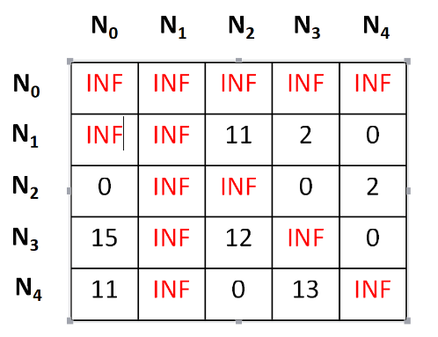
Travelling salesman Problem
The total cost at any node is calculated by making a sum of all reductions, hence the cost for the node N0 can be depicted as,
cost = 10 + 2 + 2 + 3 + 4 + 1 + 3 = 25
Now as we have founded the cost for the root node, it's the time for the expansion, and to do so, we have four more nodes namely, N1,N2,N3,N4.

Slide 25
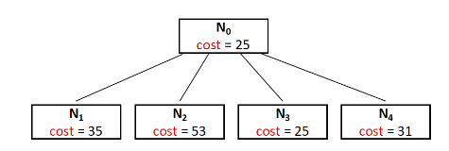
Travelling salesman Problem
cost = cost of node N0 + cost of the (N0,N1) position(before setting INF) + lower bound of the path starting at N1 = 25 + 10 + 0 = 35
Hence the cost for the E-Node N1 is 35.
In a similar way we can find that,
For N2 the cost is 53,
For N3 the cost is 25,
And for N4 the cost is 31.

Slide 26
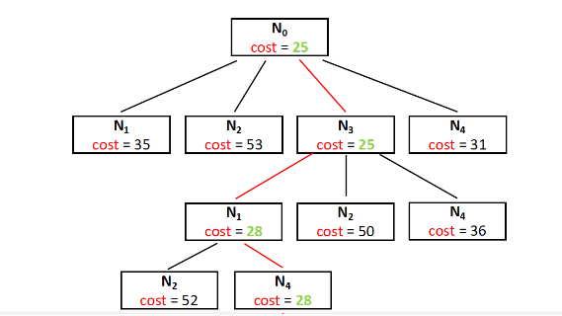
How to get towards the optimal solution ?
Here in the partially built space search tree above we have the Node N3 as the node having the minimum cost and we can consider it as the live node and extend the tree further.
This step is repeated until unless we find a dead node and can not extend the tree further.
final cost is 28, that's the minimum cost for a salesman to start from N0 and return to N0 by covering all the cities.

Slide 27
Minimax Principle
Minimax principle is decision rule used in game and decision theory.
Used to minimize the maximum loss in worst case
Initially it was proposed for two player game
Lower Bound for minimization problem
Upper Bound for maximization problem

Slide 28
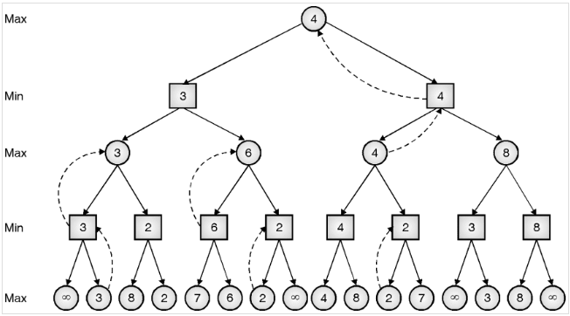
Minimax Principle

Slide 29
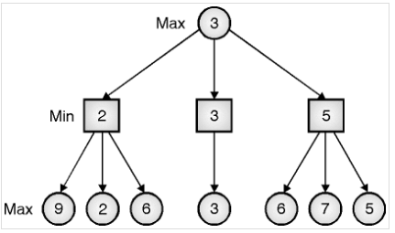
MINIMAX PROBLEM
Suppose its max’s turn, so he will try to achieve maximum points, i.e. 9. Min will propagate minimum value from its descendents. If max chose left branch, he will end up with just 2 points. On right branch, min propagates minimum value 5 on level two, so if max chose right branch, he can earn 5 points. Out of all three, right branch can give maximum advantage to max, so he will select right branch move. This is how minimax principle works.

